Slide 1
Online Music store database
Submitted To:
Prof. Angelina Ziesemer
Submitted By:
Jaspreet Singh Kaberwal (8622568)
Miki Narayanbhai Patel (8622608)
Vishwa Wani (8622587)

Slide 2
Introduction
This database is for online music store to keep the records of the users’ details like playlists, account details, subscription details etc.
It contains songs, artists details, albums of the artists tables as well.

Slide 3
The EER Model for the Database
Enhanced Entity Relationship model (EER) is a tabular representation of the database.

Slide 4
There are total eight tables in this database
Customers
Playlists
Songs
Albums
Genres
Artists
Address
payments

Slide 5
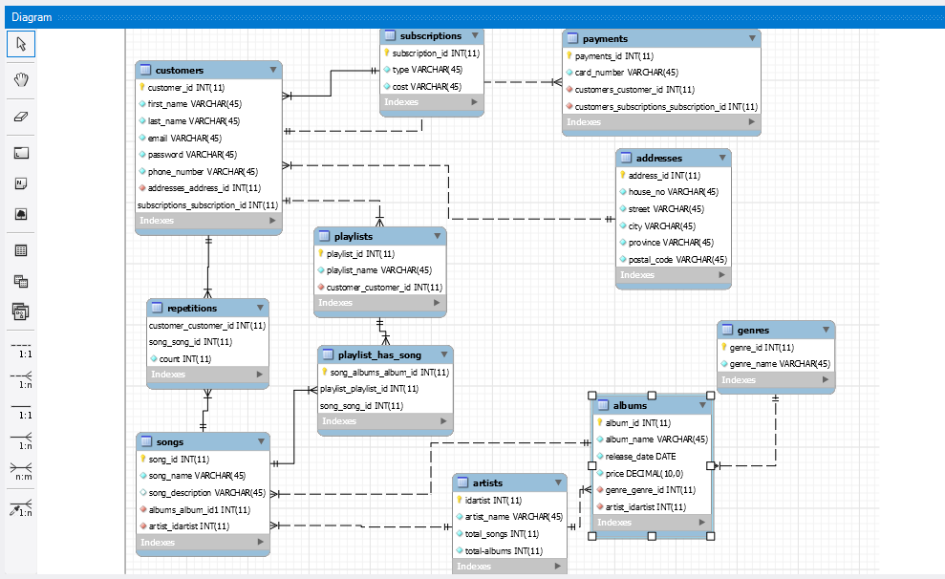
EER Model

Slide 6
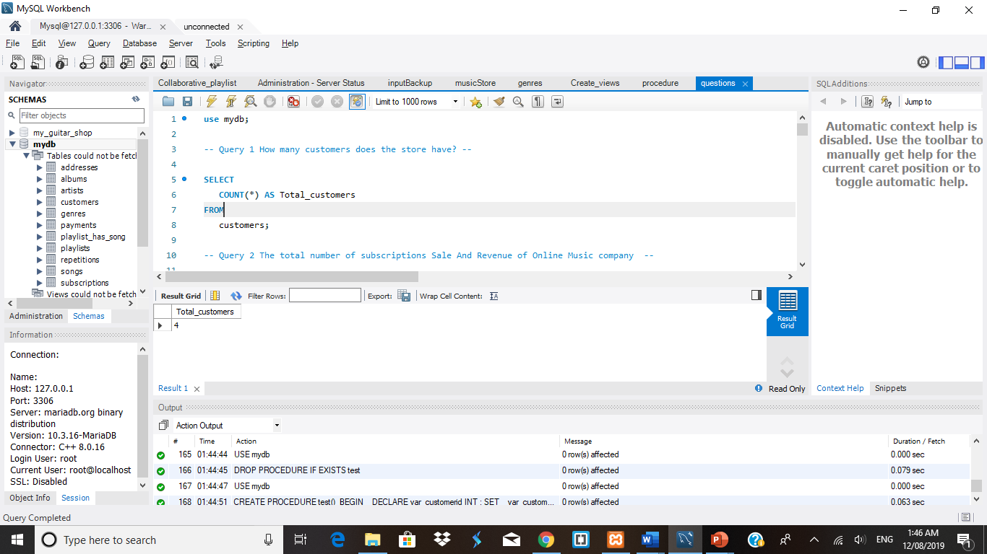
Query 1
SELECT COUNT(*) AS Total_customers FROM customers;

Slide 7
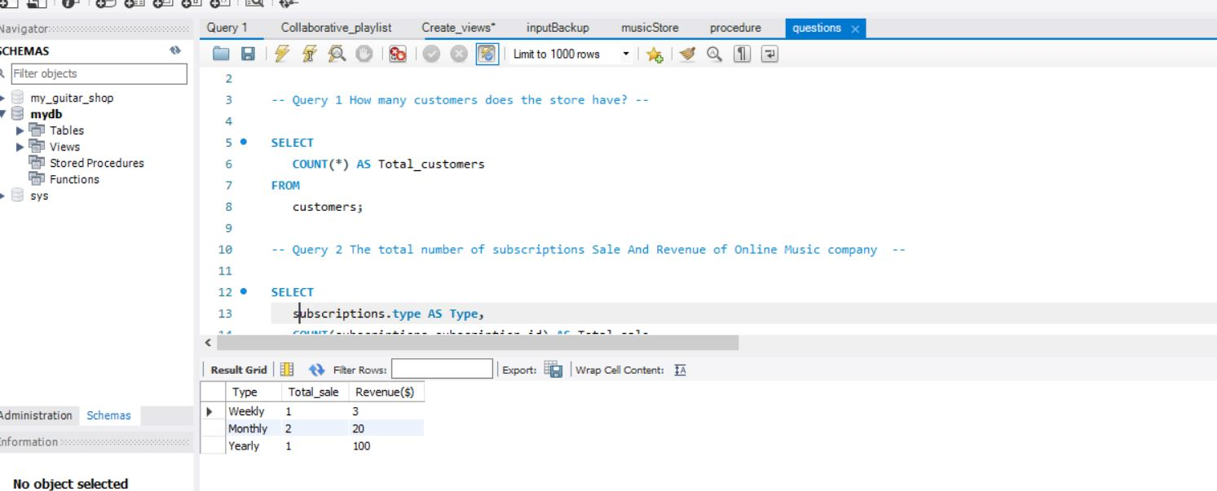
Query 2
SELECT subscriptions.type AS Type, COUNT(subscriptions_subscription_id) AS Total_sale, SUM(subscriptions.cost) AS 'Revenue($)’
FROM customers
JOIN subscriptions
ON customers.subscriptions_subscription_id = subscriptions.subscription_id
GROUP BY subscriptions_subscription_id;

Slide 8
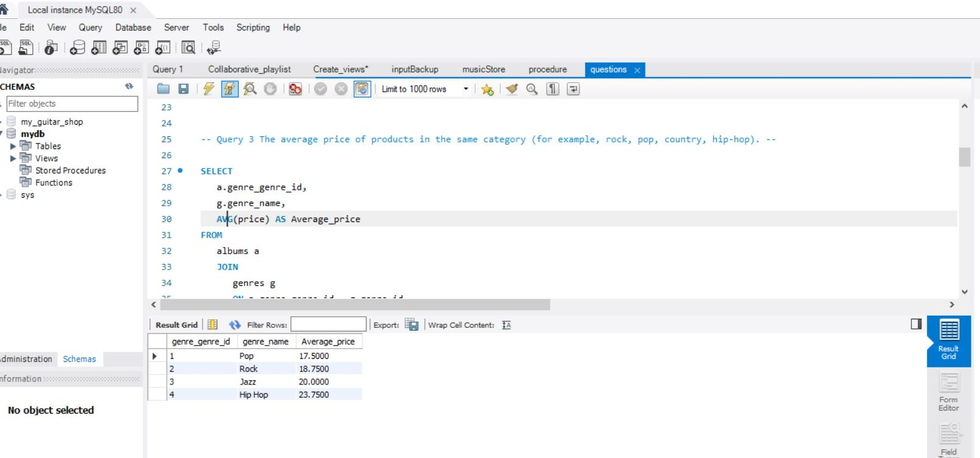
Query 3
SELECT a.genre_genre_id, g.genre_name, AVG(price) AS Average_price
FROM albums a
JOIN genres g
ON a.genre_genre_id = g.genre_id
GROUP BY genre_id;

Slide 9
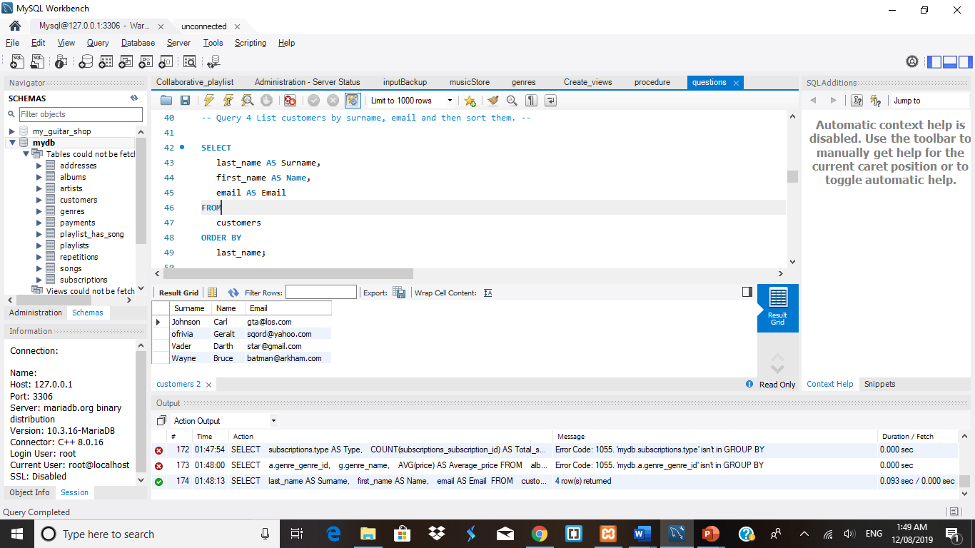
Query 4
SELECT last_name AS Surname, first_name AS Name, email AS Email FROM customers ORDER BY last_name;

Slide 10
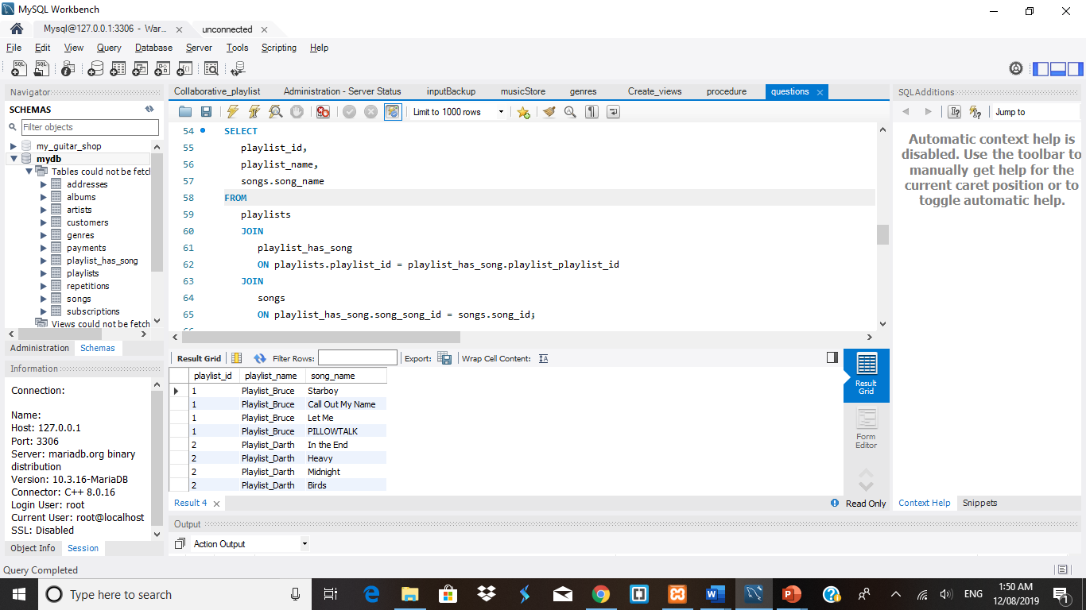
Query 5
SELECT playlist_id, playlist_name, songs.song_name
FROM playlists
JOIN playlist_has_song
ON playlists.playlist_id = playlist_has_song.playlist_playlist_id
JOIN songs
ON playlist_has_song.song_song_id = songs.song_id;

Slide 11
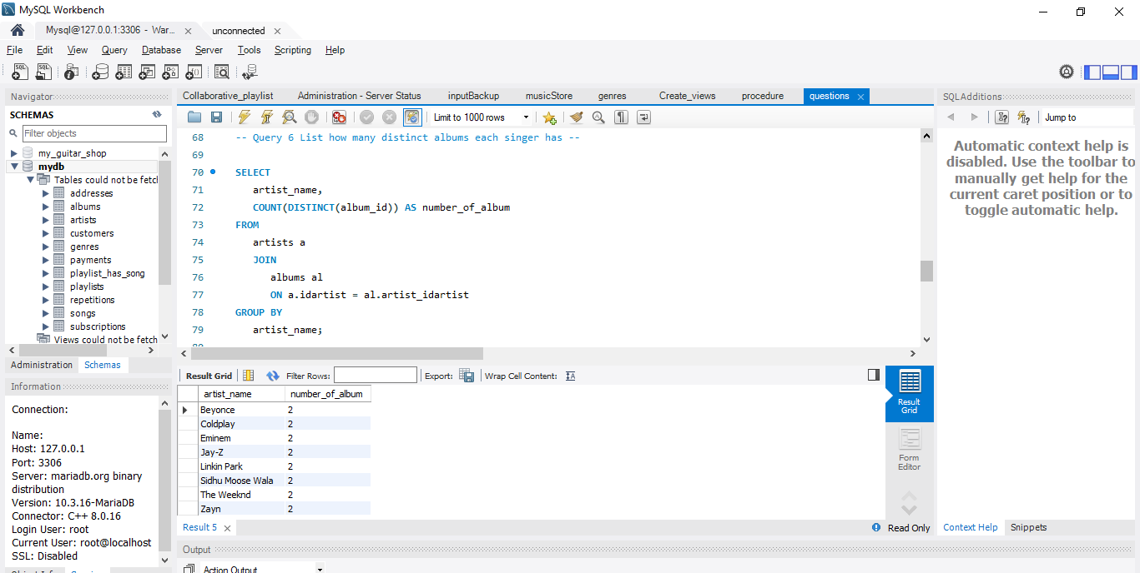
Query 6
SELECT artist_name, COUNT(DISTINCT(album_id)) AS number_of_album
FROM artists a
JOIN albums al
ON a.idartist = al.artist_idartist
GROUP BY artist_name;

Slide 12
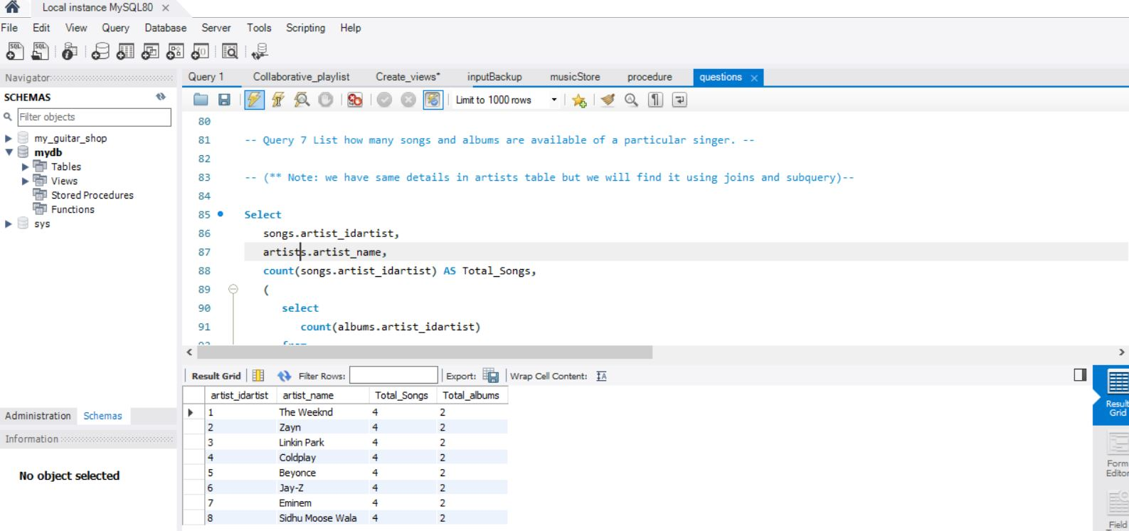
Query 7
Select songs.artist_idartist, artists.artist_name, count(songs.artist_idartist) AS Total_Songs, ( select count(albums.artist_idartist) from albums Where albums.artist_idartist = artists.idartist ) AS Total_albums
from songs Join albums ON songs.albums_album_id1 = albums.album_id Join artists On albums.artist_idartist = artists.idartist Group by songs.artist_idartist;

Slide 13
Scenario
Our scenario is to design music playlist according to listing pattern/taste of each user.
These are two questions arise as below:
User listens to one singer frequently, the album has many songs, some songs are collaborative; i.e.; they have one or more singer. So how can we recommend individual songs of the other artist whom the user is not listening in particular but listen to collaborative songs.
Create collaborative playlist for one or more users, fetching similar songs.

Slide 14
Solution for the scenario
To justify scenario, we created views and procedures.
We used songs, genres, albums tables for views and procedures.
We define procedure to create views & for the questions we used that views in the procedure.

Slide 15
Query for the scenario
USE mydb;
DROP PROCEDURE IF EXISTS test;
DELIMITER //
CREATE PROCEDURE test()
BEGIN
DECLARE var_Customer_1 INT ;
DECLARE var_Customer_2 INT ;SET-- Enter customer id's --
var_Customer_1 = 2;
SET var_Customer_2 = 1;
SELECT repetitions_genres.customer_customer_id, song_id, song_name, Songs_genre.genre_name
FROM Songs_genre
JOIN repetitions_genres
ON Songs_genre.genre_name = repetitions_genres.genre_name
WHERE Songs_genre.genre_name IN ( SELECT genre_name FROM repetitions_genres WHERE customer_customer_id IN (var_Customer_1 ,var_Customer_2 ) );
END//
DELIMITER ;
CALL test();

Slide 16
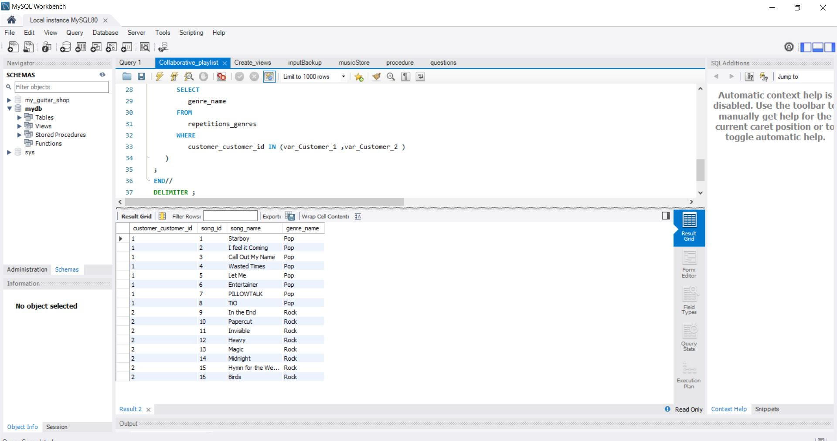
RESULT FOR THE SCENARIO

Slide 17
Query for the procedure
USE mydb;
DROP PROCEDURE IF EXISTS test;
DELIMITER // -- This select statement take reference from Views to find taste of customer and create playlist suggesting songs of similar genre –
CREATE PROCEDURE test()
BEGIN
DECLARE var_customerid INT ;
SET var_customerid = 1; -- Select customer –
SELECT repetitions_genres.customer_customer_id, song_id, song_name, Songs_genre.genre_name
FROM Songs_genre
JOIN repetitions_genres
ON Songs_genre.genre_name = repetitions_genres.genre_name
WHERE Songs_genre.genre_name = ( SELECT genre_name FROM repetitions_genres WHERE customer_customer_id = var_customerid );
END//
DELIMITER ;
CALL test();

Slide 18
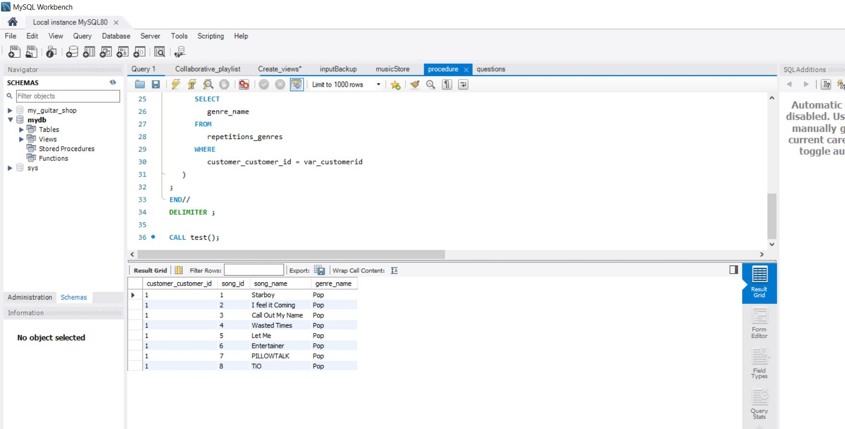
Result for the procedure

Slide 19
Conclusion
The database has been designed to keep records of the users, songs, artists of the Online Music Store.
EER model is developed to define the relations between tables.
The system has been tested for several inputs to check the column definition, queries, scenarios and the questions.

Slide 20
THANK YOU

